Slide 1
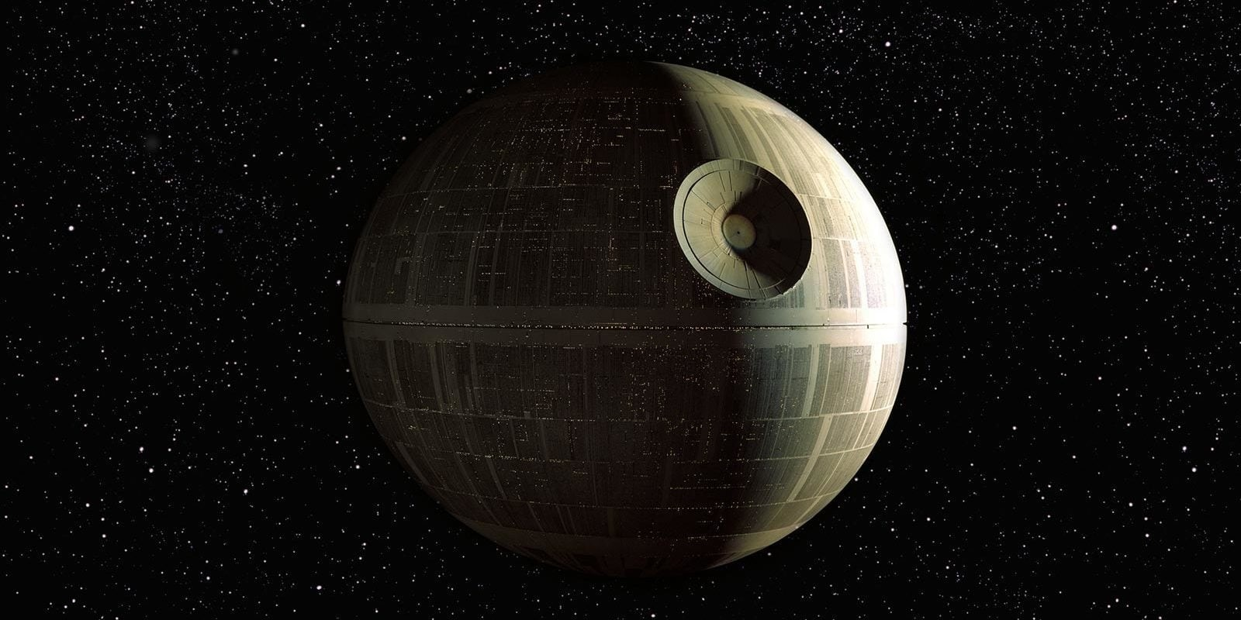
For The Glory of the Empire
Group 14

Slide 2
With the unfortunate demise of our colleagues (which we most assuredly had nothing to do with), we have stepped in to analyze the monthly inflow of Imperial Credits.
Through our expert analysis of the past data and accurate modeling of next year’s expected credit flow, the Empire will have a much clearer picture of their finances and will be able to greatly increase funding to the construction of the Death Star, the procurement of new TIE Fighters, and an increase in the budget for, shall we say, nefarious activities.

Slide 3
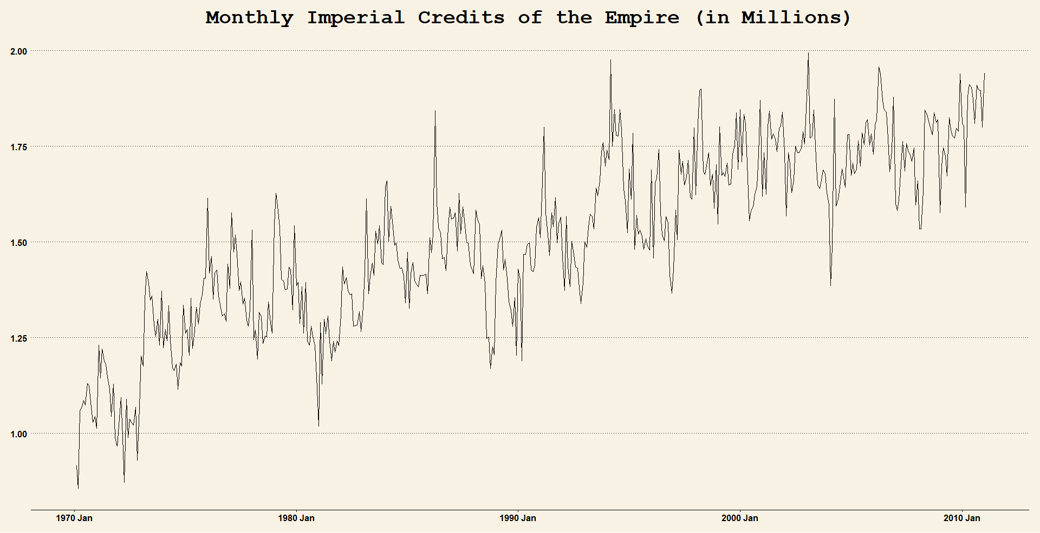
Provided Data
This graph shows the steady monthly increase of our Imperial Credits. Clearly, we are a very financially successful Empire with no chance of failure. Nope, none at all.

Slide 4
In order to determine the model that best fit our data without an excessive amount of overfitting, we had to use the dark side of the force and perform some code wizardry. We performed many simulations of many models of different kinds (which came at a great cost to our personal free time). We tried ARIMA models, exponential smoothing with trend models, naïve models… pretty much if you could think of it, we tried it.

Slide 5
After performing all the modeling simulations, we found that a specific ARIMA model (ARIMA((1,0,0) (0,2,1)) best fit the data. This is a fairly complex model that takes a bit of time to wrap your head around.

Slide 6
Essentially, an ARIMA model tries to explain the data by using the previous data. The numbers in the first set of parentheses correspond to data that is not seasonal; the second set of parentheses is for data that is seasonal. The first number in parentheses is the order of the autocorrelation (how much, if any, the data is associated with itself). The second number is the degree of differencing (the number of times the data is differenced). The third number is the order of the moving average (the amount of terms in the moving average part of the equation).

Slide 7
Why is this the best model, you may be asking yourself (this is good, you should always be cautious that enemies from the rebellion have infiltrated the glorious Empire and are working to sabotage by delivering bogus predictions). The chosen ARIMA model has a low Root Mean Squared Error (RMSE), an RMSE of 0.141; in a non-technical wording, the ARIMA ((1,0,0) (0,2,1)) model has the lowest typical miss when comparing our predicted data to our actual data.

Slide 8
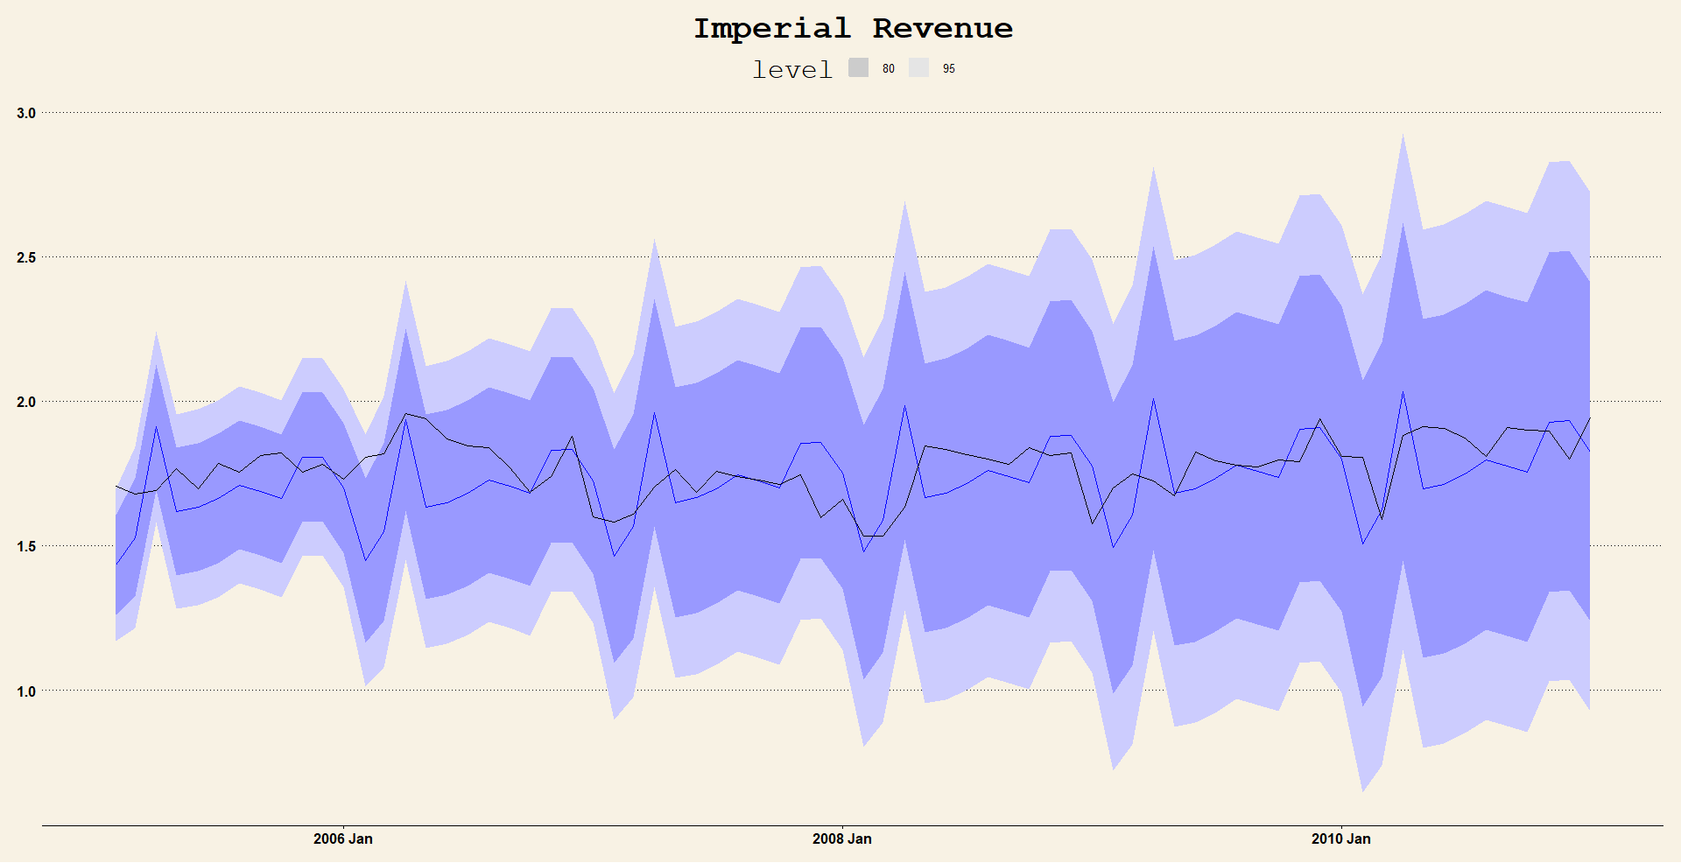
This graph shows the most recent six years of our data with our model’s prediction for those same six years.
Actual values in black. Model predicted values in blue.

Slide 9
The strange looking shading on the previous slide is the confidence intervals for our model, with the darker shading being a less accurate interval (and therefore smaller). The lightly shaded confidence interval is telling you “Hey, look at me. Yes, the line in blue is what I’m pretty sure the value is here, but I’m 95% sure that the *actual* value is within this range.” The darker shading area is the exact same thing, only instead of 95% sure, it’s only 80% sure. As we get further away from the start of the model we become more and more uncertain of the accuracy of our model, which explains the ever-increasing size of the interval.

Slide 10
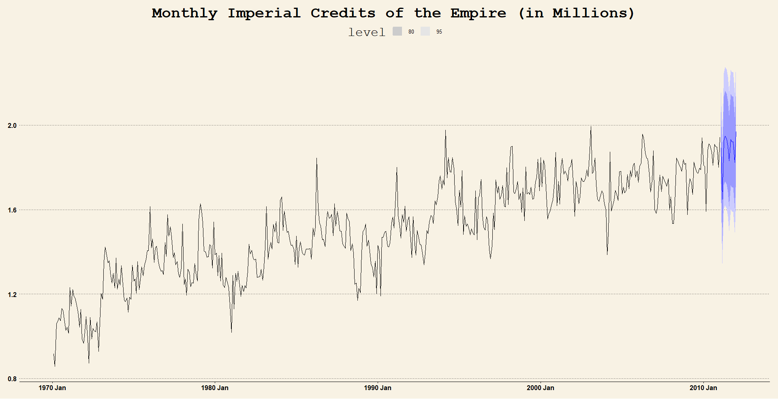
The provided data is in black. Our model (ARIMA ((1,0,0) (0,2,1)) is in blue.

Slide 11
Month
1
2
3
4
5
6
7
8
9
10
11
12
Imperial Credits (Millions)
1.89
1.65
1.93
1.95
1.93
1.90
1.83
1.93
1.92
1.92
1.82
1.97
These are our predictions of the next twelve months’ Imperial Credits.

